Slide 1

Property market research for the past 3 decades
A property agent’s view

Slide 2

Process
Data Collection
Combining Data
Data Cleaning
Standardise descriptions
Feature Engineering
Region
Price per sqm
Flat model
Year & month
Storey
No. of years since lease commencement
Data Visualisation
CDF
Scatterplot
Lineplot
Stackplot
Heatmap
Purpose
Most profitable portfolios:
Pricing
Location
Property age
Check missing values

Slide 3
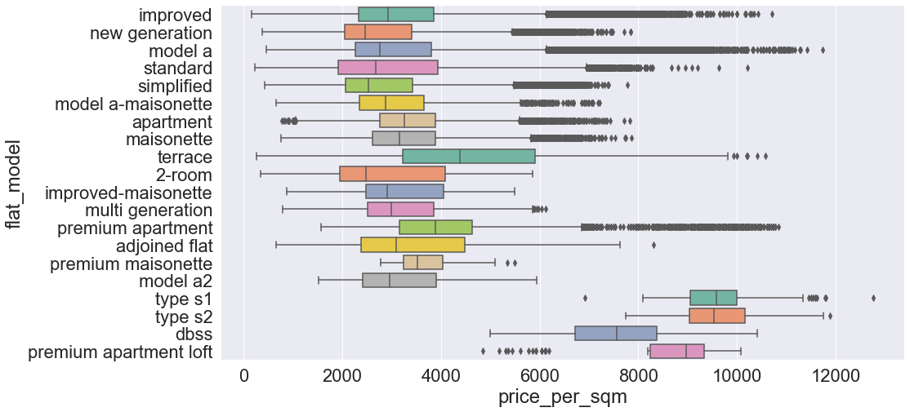
Focus: Standard (non-premium) flat models
X
X
X
X
X
X
X

Slide 4
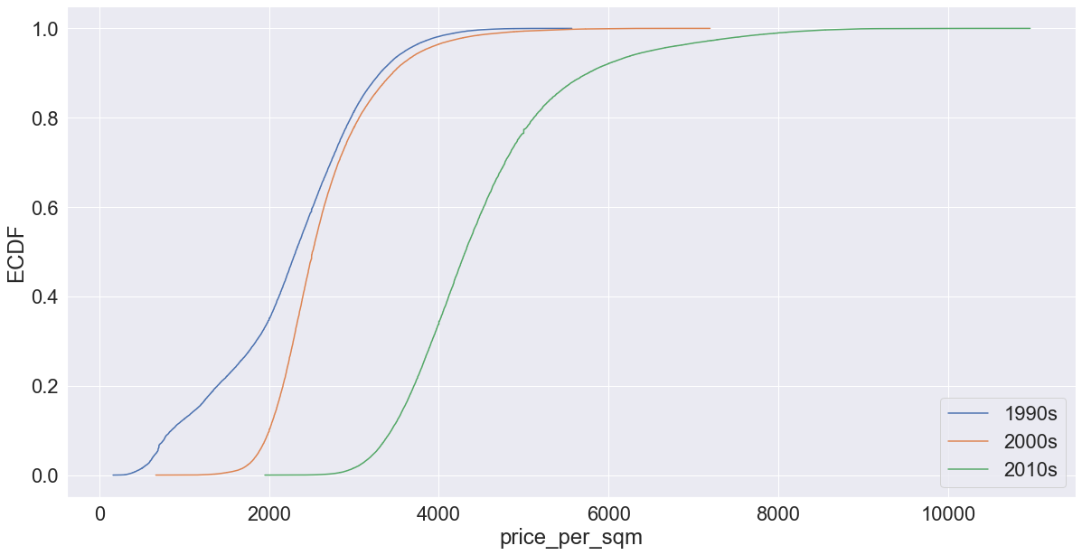
Distribution of prices in the last 3 decades
50th percentile
VOLUME: Lower price points
PRICE: Greater gain in value for higher price points in the last decade
CHOICE OF PORTFOLIO: Higher price over volume as distribution is starting to normalize in the recent decade
*Sample size = 100,000

Slide 5
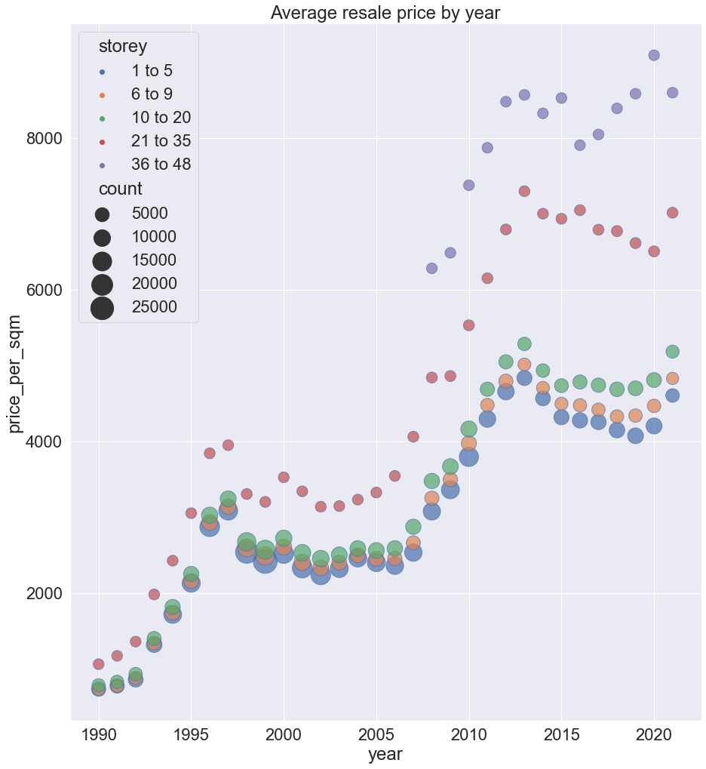
Higher vs lower-floor units
VOLUME:
Loss in volume for lower floors relative to higher floors
PRICE:
High floor units are increasing in price more rapidly than low floor units (<20th storey)
PORTFOLIO CHOICE:
Higher floor units

Slide 6
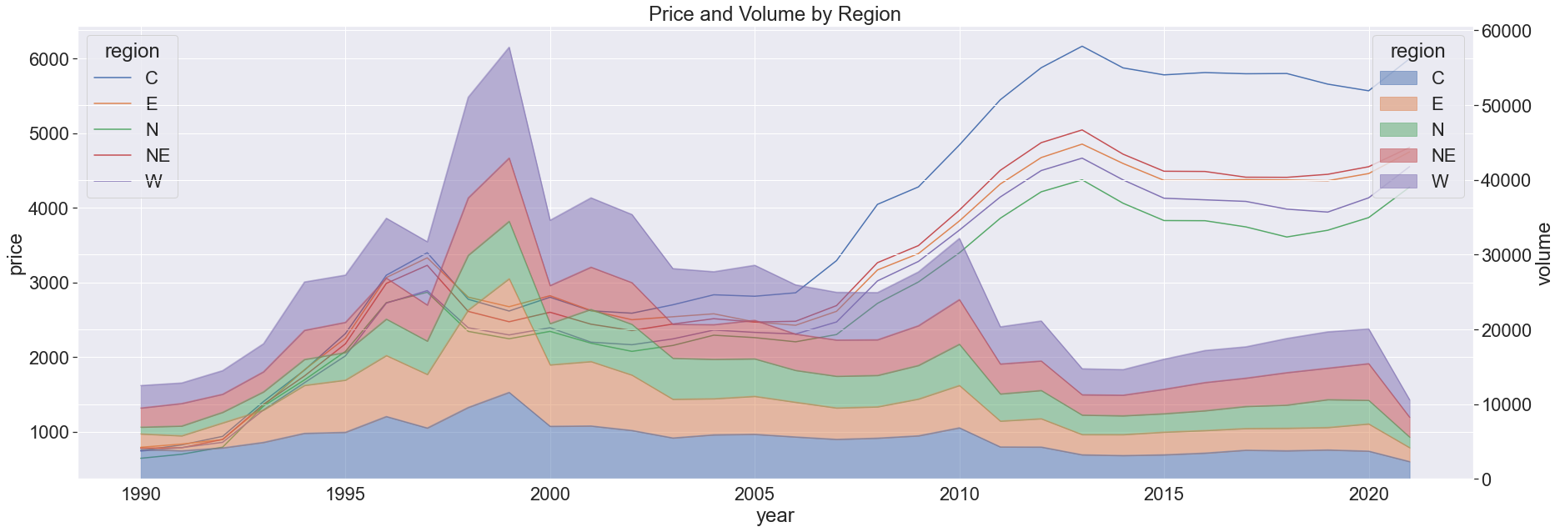
CHOICE OF PORTFOLIO: Central and North-east Note that volume is going down post-2020 further supports the choice of portfolio
VOLUME: Increasing consistency across regions, slightly increasing trend for Central and North East area
PRICE: Significant gain in central area followed by north-east

Slide 7
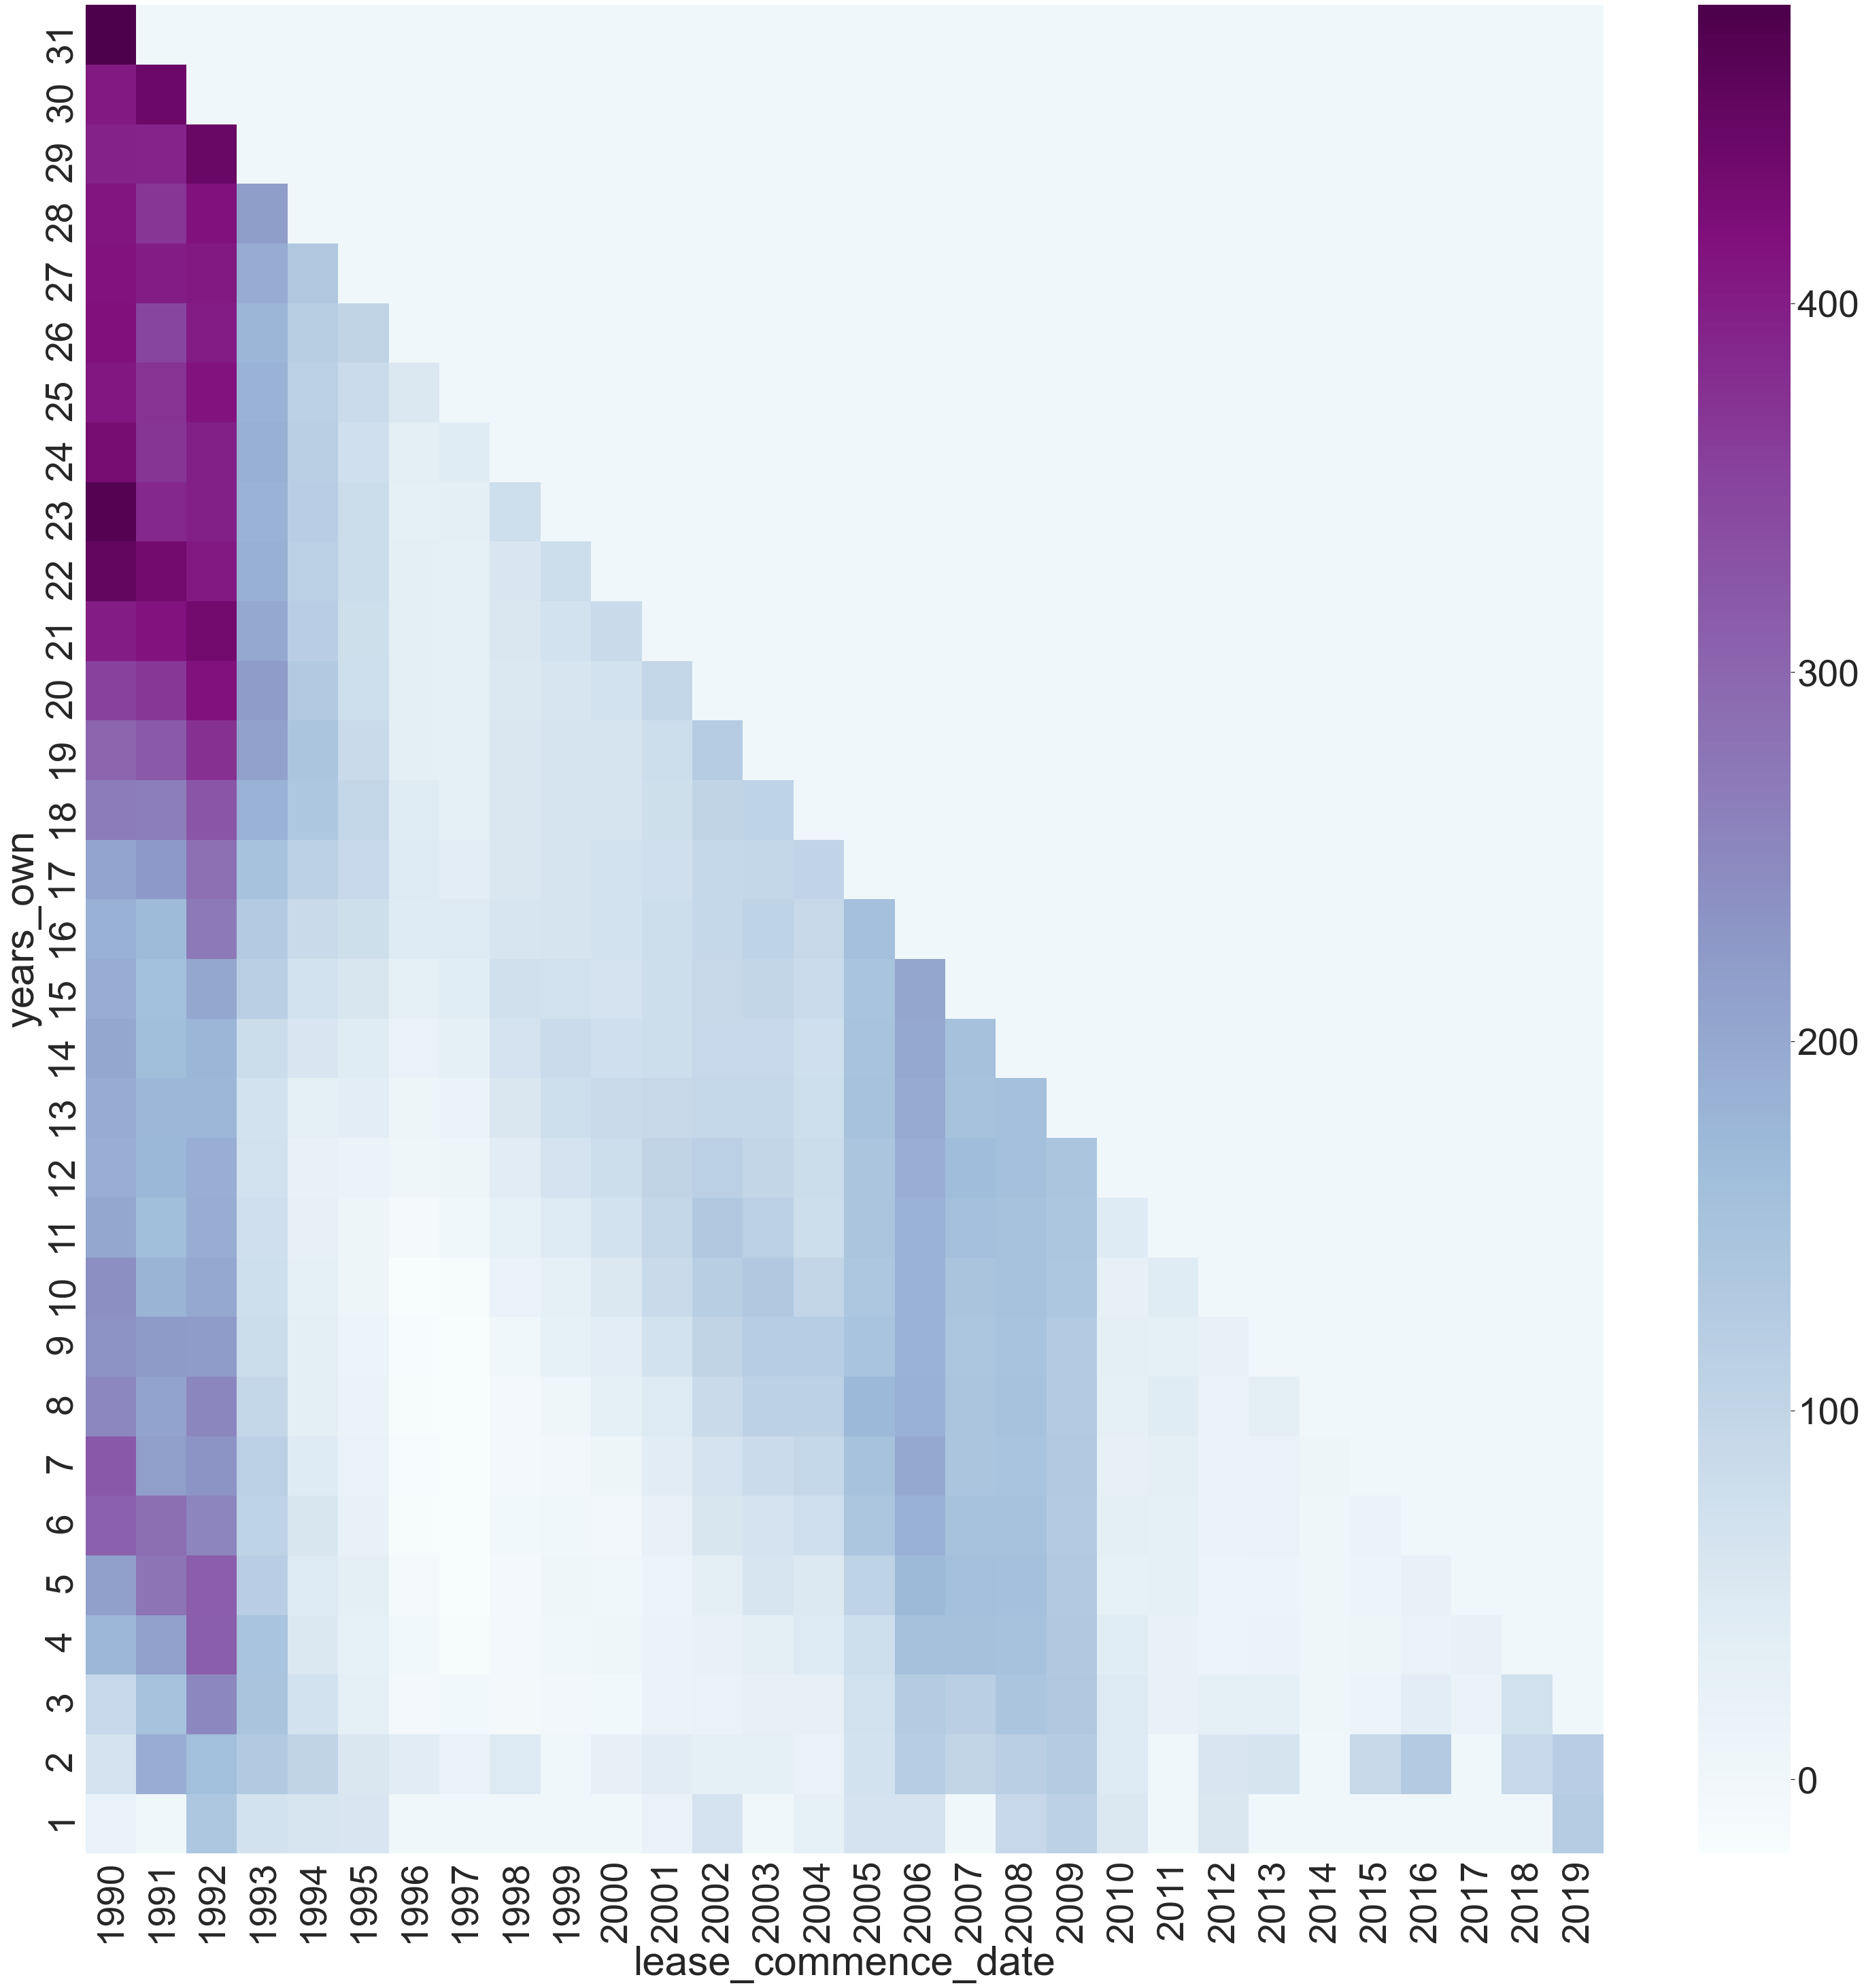
Property age: no. of years since lease commencement
CHOICE OF PORTFOLIO:
The chart shows that optimal no of years to hold the property is approx.7- 15 years.
Gaps:
Returns do not consider inflationary impact which should lower the returns
Analysis assumes an initial price that is based on resale prices

Slide 8
Conclusion
For higher profitability:
More central area
Higher floor units to be developed
15-year old resale flats

